Slide 1

Placement Assistant System

Slide 2

Content
Introduction
Problem Statement
Analysis
Proposed System
Components
Features
Benefits
Customer Revalidation

Slide 3
Introduction
Our system is a web application which helps in online job recruitment process, which would meet the requirements of companies and also the job seekers.

Slide 4

Problem Statement
In the present time, many people are not getting jobs according to their abilities. Many of them are sacked from the company after
one or two years because they are not happy with their performance. These problems are because of the unavailability of a proper platform on which recruiters and job seekers can properly interact with each other.

Slide 5
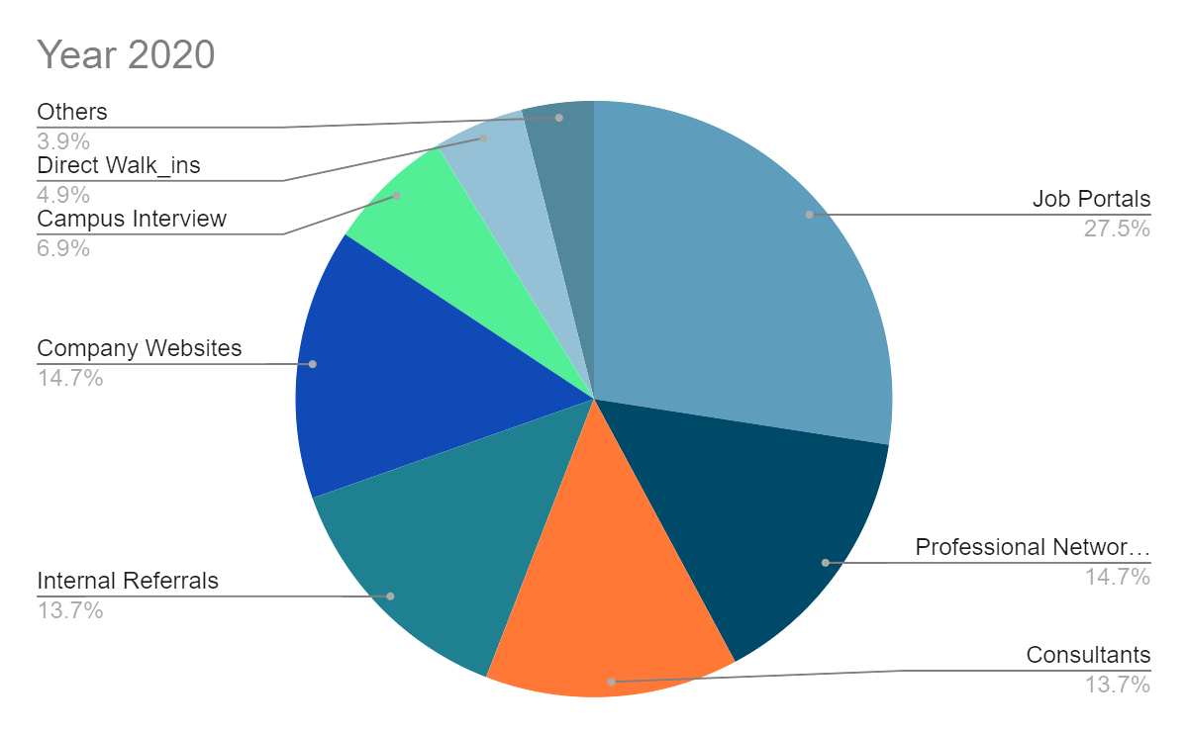
Statistical Analysis
In Year 2020, Growth in Online Recruitment was seen in comparison of past years.

Slide 6
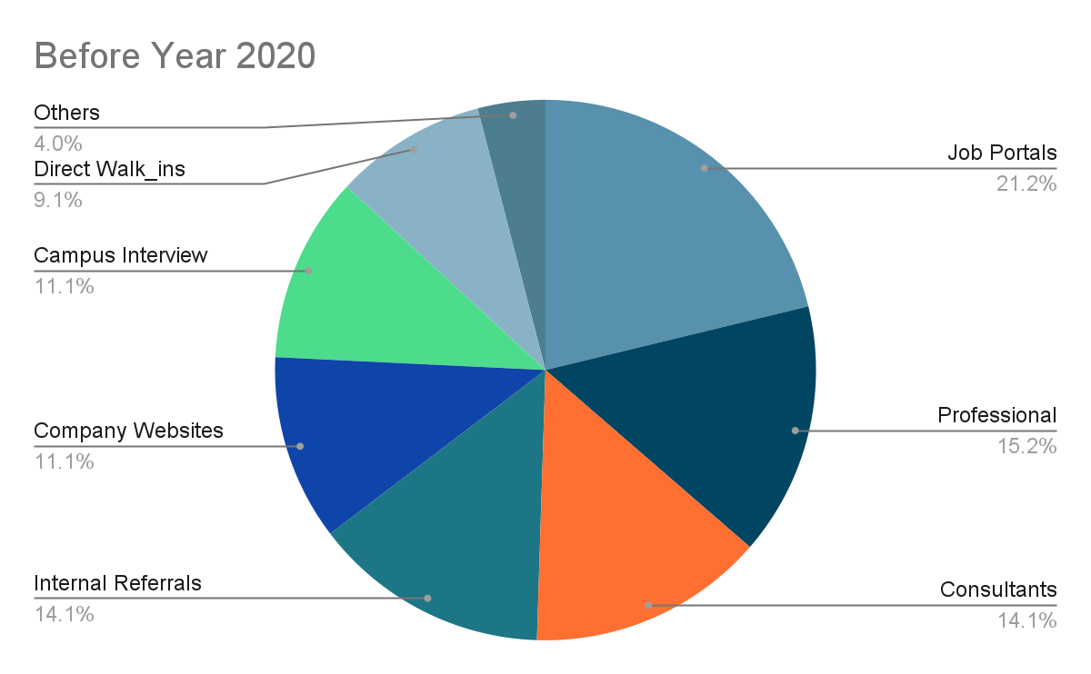
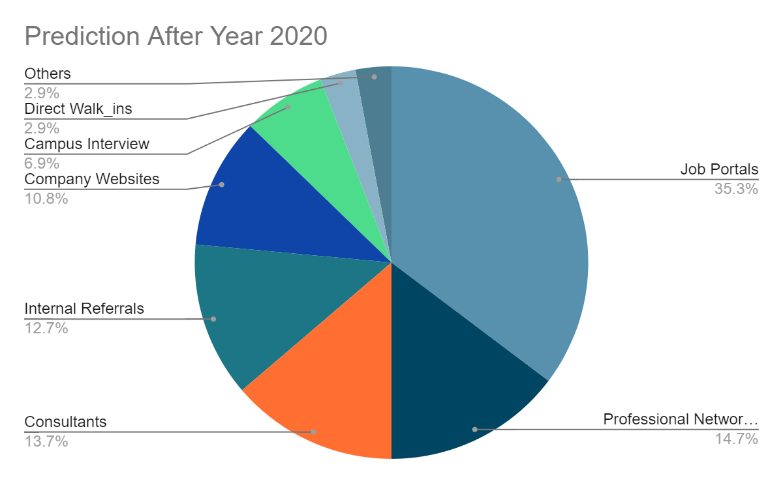
Statistical Analysis

Slide 7

Proposed System
According to our Problem Statement and data analysis, We have proposed a Web Platform, for all the job seekers and Company HRs, so that they could be present on the same platform and help out each other in order to fulfill each others' requirements.

Slide 8
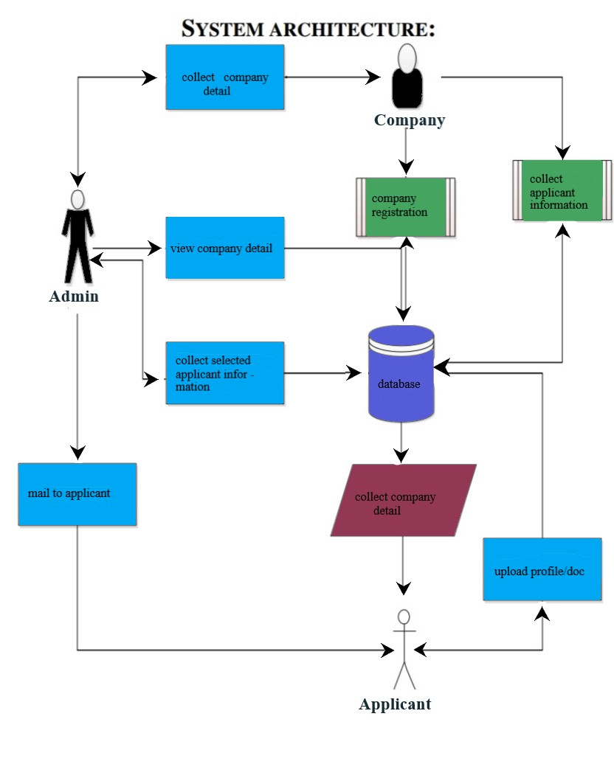
System Architecture
A system architecture is the conceptual model that defines the structure, behavior, and more views of a system.
A system architecture can consist of system components and the sub-systems developed, that will work together to implement the overall system.

Slide 9
System Required/Props
List of hardware used:
Hardware Device | Configuration
System | 64 bit
HDD | 1 tb
RAM | 8 gb

Slide 10
System Required/Props
List of software used:
Software Devices
Platform | Browser
Language | HTML,CSS
Database | Oracle SQL
Configuration

Slide 11

Features
Provides a single platform where applicant can search as well as apply for different types of job preferred by them.
Applicant as well as Managers would be duly notified through notifications to acquire the information.

Slide 12
Features
It conducts online interview which could be very useful in this pandemic situation.
Application facilitates to provide the rank position of company world wide and if applicant wants to apply for foreign countries or at international level, it is provided too.

Slide 13

Benefits
Get Connected
Company gets better Employee
Applicant would gain knowledge from others
Cost Effective
Time Efficient
Professional Environment
Benefits

Slide 14
Objective
Helpful in fast access procedures in placement related activities.
The proposed system intends user-friendly operations which may resolve ambiguity.
Time saving.
Easily finding out the list of eligible applicant for company training and placement.
Provides a safe and secure placement for the applicant.

Slide 15
Customer Revalidation
This platform allows to find the job easily and in less amount of time. Surely recommended to my friends.
I was finding job for myself for like a year and I found this website and today I found a perfect one.
Thank You!!!
Very Impressive and effective website for job seekers.

Slide 16

Developers
Dhairyansh
Priyanshi
Nidhi
Astha

Slide 17


